Slide 1
GSBA 511: Managerial Economics
Prof. Akbulut
Chapter 3

Slide 2
Chapter 3: Outline
Where Prices Come From: The Interaction of Supply and Demand
Demand functions
Supply functions
Equilibrium
Shifting demand and supply curves

Slide 3
Model of Supply and Demand
Model designed to explain how prices are determined in certain types of markets.
Main assumption:
Perfectly competitive market
A market that meets the conditions of (1) many buyers and sellers, (2) all firms selling identical products, and (3) no barriers to new firms entering the market.

Slide 4
Demand Side of the Market
Quantity demanded: The amount of a good or service that a consumer is willing and able to purchase at a given price.
Demand schedule: A table that shows the relationship between the price of a product and the quantity of the product demanded.
Demand curve: A curve that shows the relationship between the price of a product and the quantity of the product demanded.
Market demand: The demand by all the consumers of a given good or service.

Slide 5
Demand Side of the Market
Demand Function:
A relationship between quantity demanded and other (independent) variables.
A rule that assigns a single value to quantity demanded for any set of values of the other variables
Demand is generally viewed as a flow:
Gallons of gasoline demanded per month
Pairs of shoes demanded per year
Slices of bread demanded per day, etc.

Slide 6
What affects the demand?
Income
Normal vs. Inferior goods
Prices of Related Goods
Substitutes vs. Complements
Tastes
Population and Demographics
Expected Future Prices

Slide 7
The general demand function
Quantity demanded of good x is dependent upon its own price, income of consumer(s), price of good(s) y, and other things.
For example:
This shows a statistical relationship.

Slide 8
If we have one dependent variable and n independent variables, how many dimensions do we need to draw the relationship graphically?

Slide 9
Recall our Example
Now let I=300 and P_{y}=50
Demand function:
Inverse demand function:

Slide 10
Plot of a demand curve:
P
325
Demand curve
(Plot of the inverse
demand function)
Slope =ΔP/ΔQ = -5
ΔP
ΔQ
65
Q

Slide 11
Shifts in Demand versus Movements along a Demand
Shifts in Demand
is caused by a non-own price change
Movement along a Demand
is caused by an own price change

Slide 12

Active Learning
Demand Curve
Draw a demand curve for gasoline. What happens to it in each of the following scenarios? Why?
A. Taxes on gasoline driven cars are increased drastically
B. The price of gasoline falls
C. The price of electricity increases drastically

Slide 13
Supply Side of the Market
Quantity supplied: The amount of a good or service that a firm is willing and able to supply at a given price.
Supply schedule: A table that shows the relationship between the price of a product and the quantity of the product supplied.
Supply curve: A curve that shows the relationship between the price of a product and the quantity of the product supplied.
Supply function: A relationship between quantity supplied and other (independent) variables.
flow

Slide 14
What affects the supply?
Price of Inputs
Technological Change
A positive or negative change in the ability of a firm to produce a given level of output with a given quantity of inputs
Alternative products that a firm could produce are called substitutes in production.
Price of Substitutes in Production
Number of Firms in the Market
Expected Future Prices

Slide 15
The general supply function
Quantity supplied depends on (own) price and cost of production.

Slide 16
Plot of a Supply Curve
P
Supply curve
(Plot of the inverse
supply function)
For example: P = 25 +3Q
Slope is ∆P/∆Q = 3
Q

Slide 17

Active Learning
Supply Curve
Draw a supply curve for tax return preparation software. What happens to it in each of the following scenarios? Why?
The price of the software drops
A technological advance allows the software to be produced at lower cost.
Professional tax return preparers raise the price of the services they provide.

Slide 18
Market Equilibrium
P
S
?
D
?
Q

Slide 19
Market Equilibrium
P
Surplus
S
1000
800
D
10
Q (millions)
8.5
12

Slide 20
Market Equilibrium
P
S
800
650
Shortage
D
8
10
Q (millions)
12

Slide 21
Effects of Demand and Supply Shift on Equilibrium
Predictions about price and quantity in our model require us to know supply and demand curves.
Typically, we know price and quantity but do not know the curves that generate them.
The power of the demand and supply model is in its ability to predict directional changes in price and quantity traded.

Slide 22
Shifting Supply and Demand
P
S
S’
D’
D
Q

Slide 23
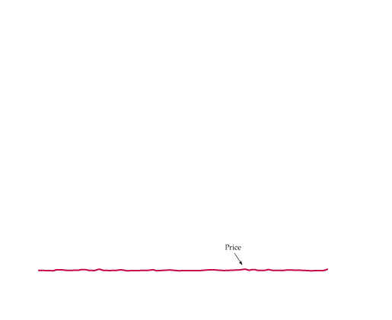
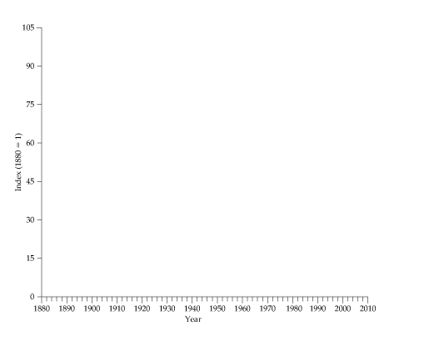
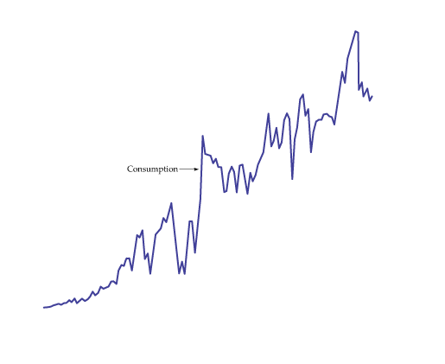
Active Learning Changes in Market Equilibrium
Consumption and the Price of Copper
Although annual consumption of copper has increased about a hundredfold,
the real (inflation-adjusted) price has not changed much.

Slide 24
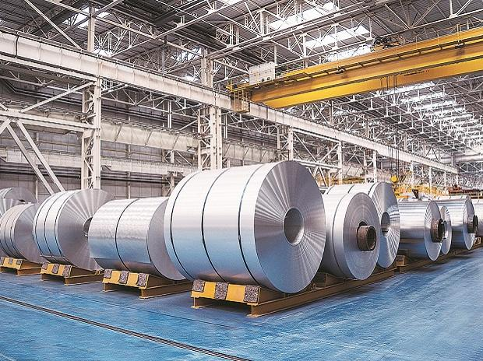
Active Learning
Market Equilibrium
Suppose that due to more stringent environmental regulation it becomes more expensive for steel production firms to operate. Also, recent technological advances in plastics has reduced the demand for steel products.
Use Supply and Demand analysis to predict how these shocks will affect equilibrium price and quantity of steel.
Can we say with certainty that the market price for steel will fall? Why?

